Slide 1

AWS Machine Learning Exam
Basic Structure
Released as a beta exam in November, 2018
March, 2019 first version of exam released for general public
$300 to take the exam
3 hours to complete approximately 65 questions
Questions will be multiple choice (pick the best answer of 4) or multiple response (pick 3 of 5)
No partial credit for multiple response questions
Can mark questions for later review
Answer all questions, even if unsure

Slide 2
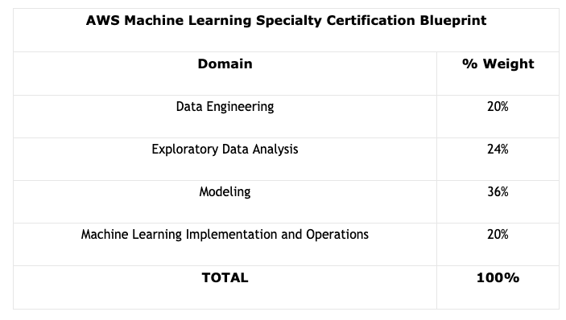
AWS Machine Learning Exam Blueprint
Domains

Slide 3
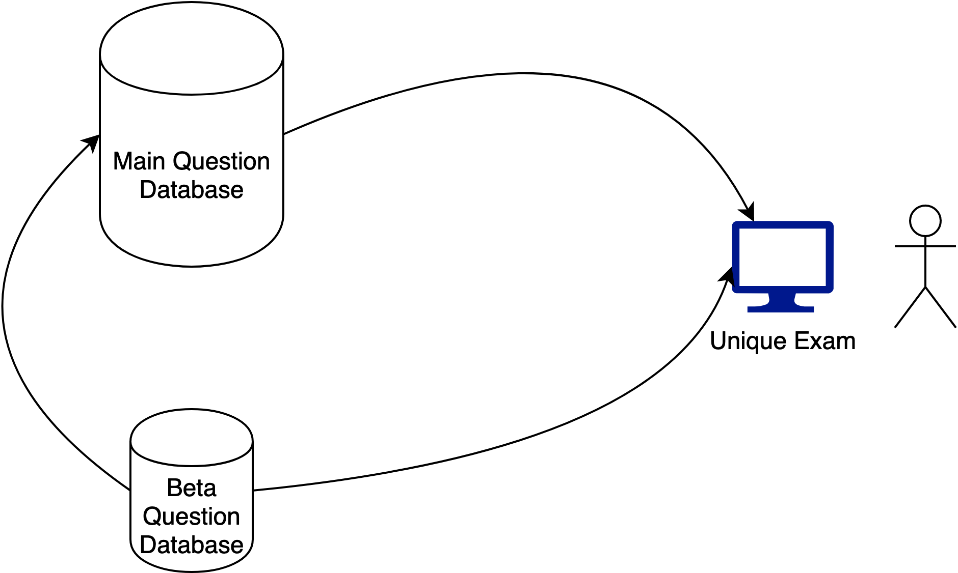
AWS Machine Learning Exam Question Sources
Beta Questions

Slide 4
AWS Machine Learning Exam Key Points
Know the questioning techniques
Select one or more responses that best complete the statement or answer the question. Distractors, or incorrect answers, are response options that an examinee with incomplete knowledge or skill would likely choose. However, they are generally plausible responses that fit in the content area defined by the test objective.
Unanswered questions are scored as incorrect; there is no penalty for guessing.
Unscored content
Your examination may include unscored items that are placed on the test to gather statistical information. These items are not identified on the form and do not affect your score.

Slide 5
AWS Machine Learning Exam Results
Pass or fail
Score between 100 and 1,000
Minimum passing score of 750
Domains at fixed percentages
Scaled scoring models are used to equate scores across multiple exam forms that may have slightly different difficulty levels.
Your score report contains a table of classifications of your performance at each section level.
Designed to provide general feedback concerning your examination performance.
The examination uses a compensatory scoring model, which means that you do not need to “pass” the individual sections, only the overall examination.

Slide 6
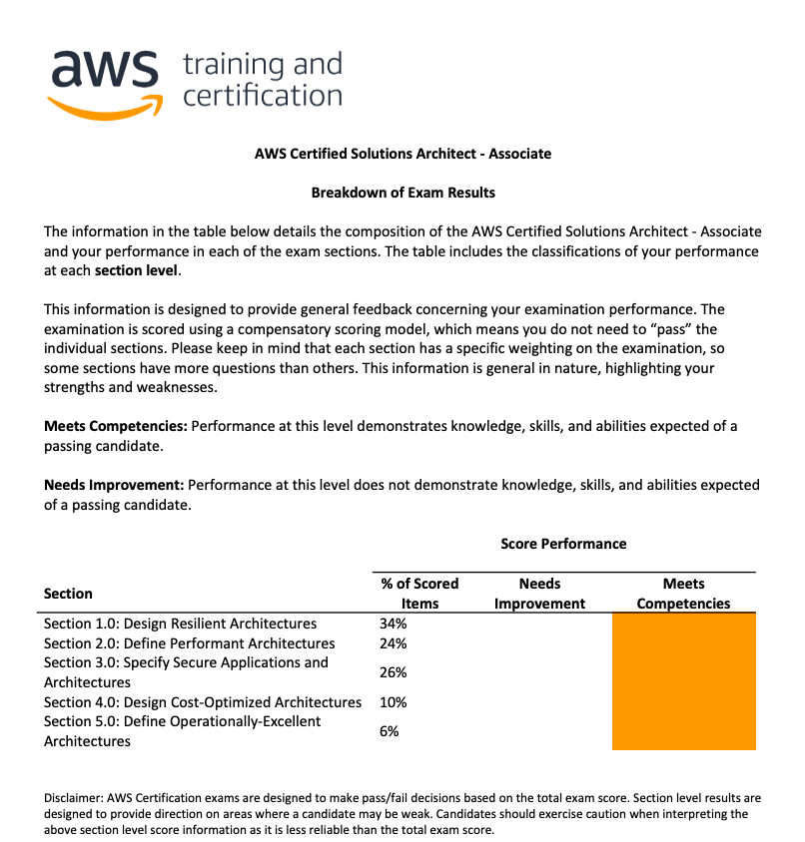
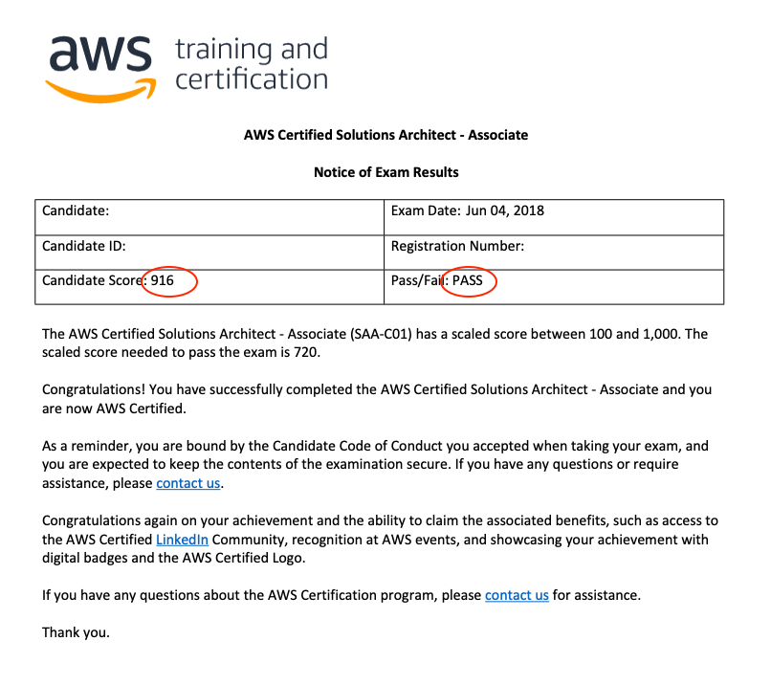
AWS Machine Learning Exam Results
Results report

